Slide 1

Paoer Turret
By: The Engineers

Slide 2
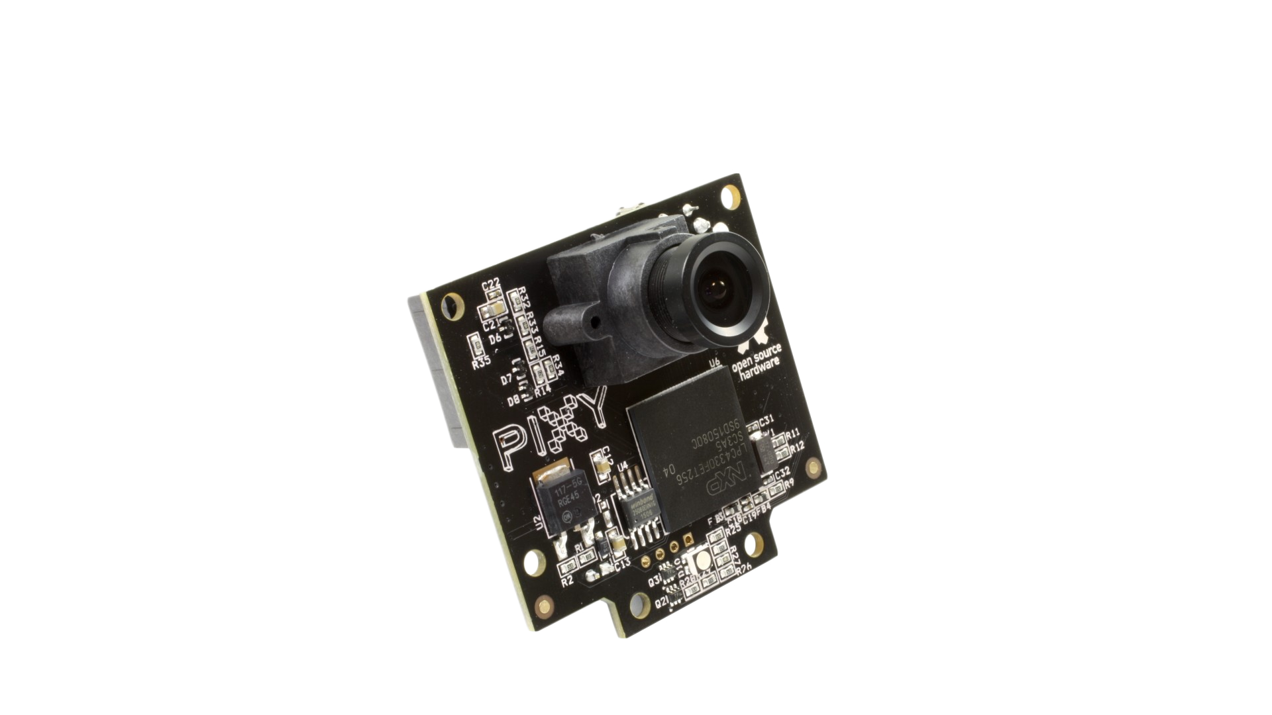
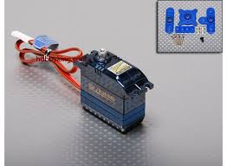
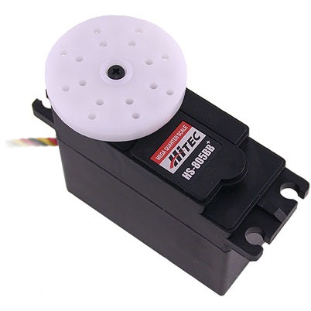
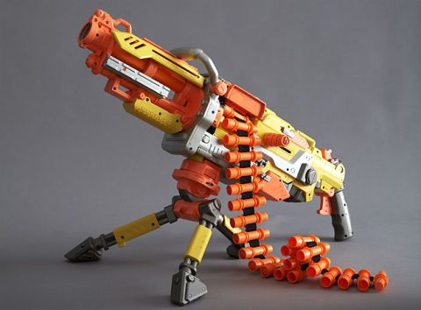
Turret Parts List
6v battery pack (Servos)
9.6v battery pack (Turret)
Electronic components (transistor, diode, and resistor)
Nerf Vulcan gun
Pixy Camera

Slide 3
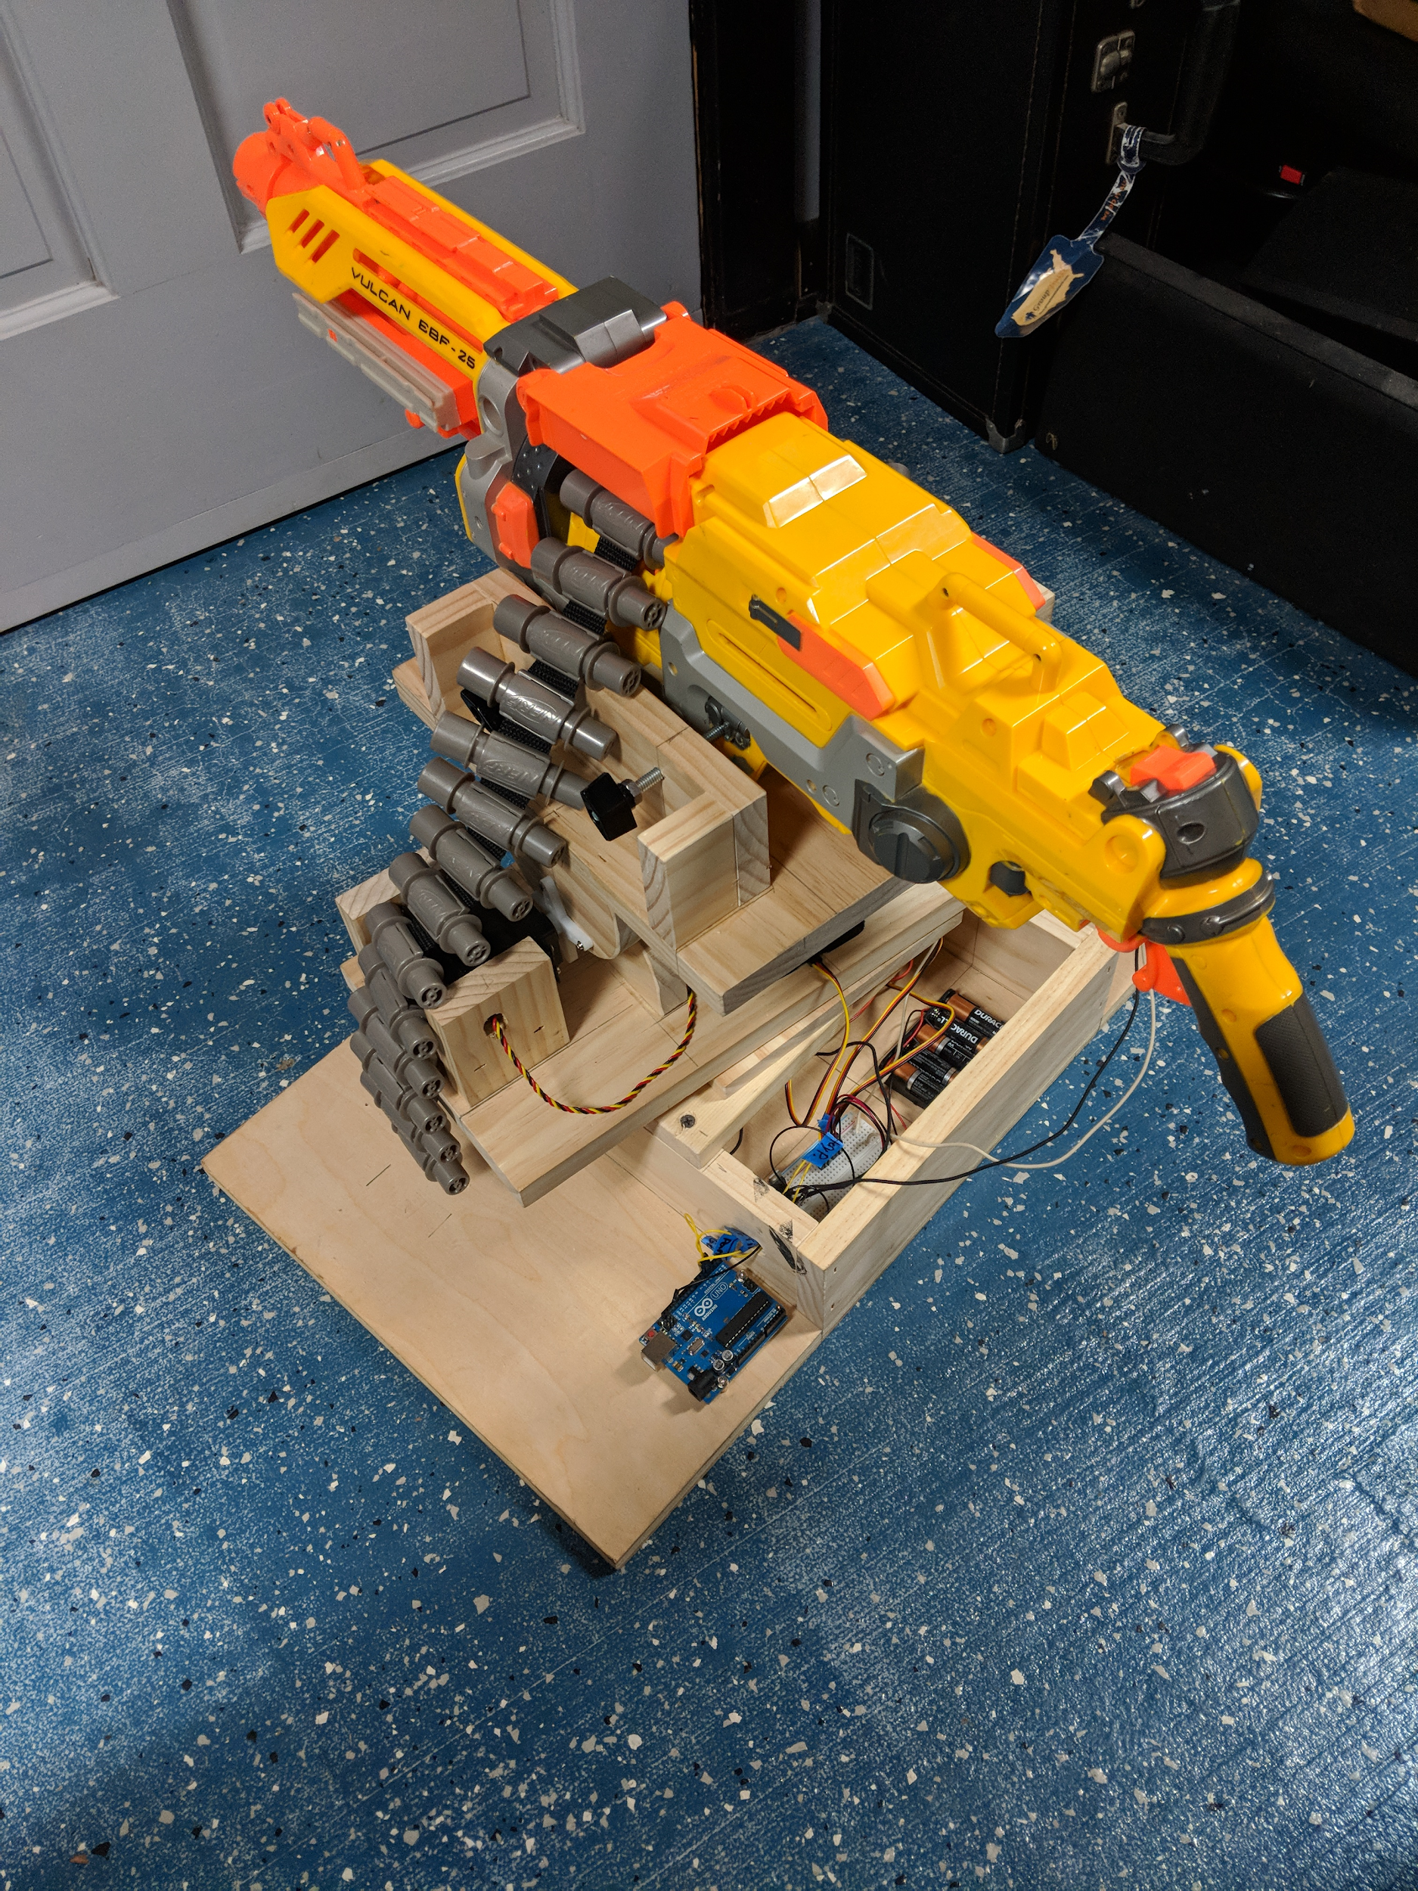
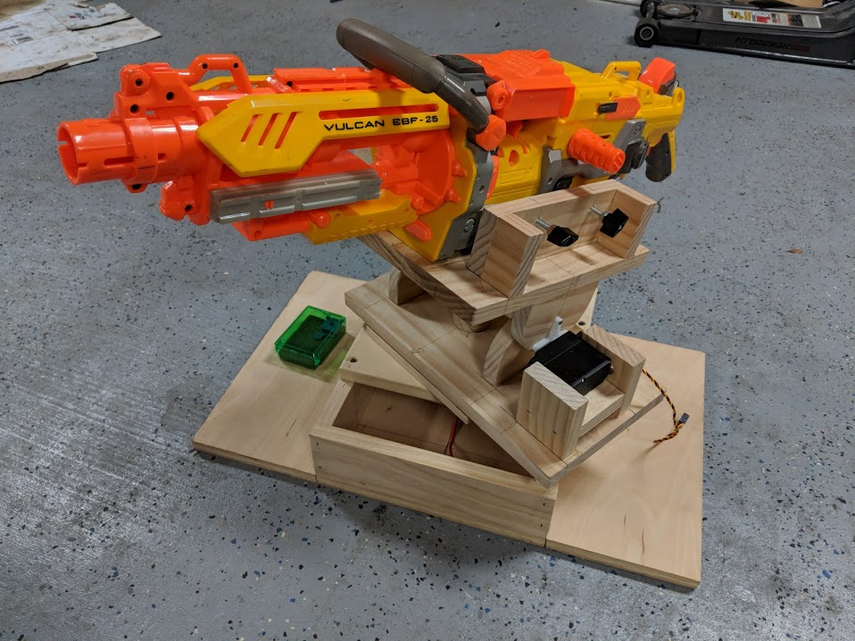
Final Progress
Autonomous control
Setting up the finalized circuit
Power maintenance
Pixy Camera control

Slide 4
Previous Troubleshooting
Power issues
Pixy camera configuration
Debugging autonomous control

Slide 5
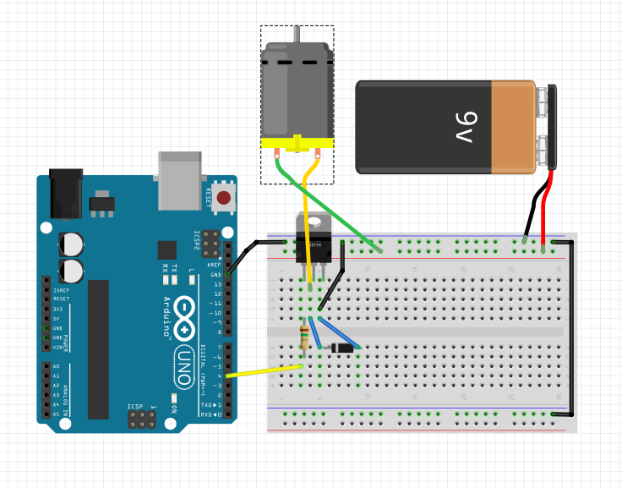
Finalizing wiring and Powering
Moving back to the proto-board
Common grounds

Slide 6
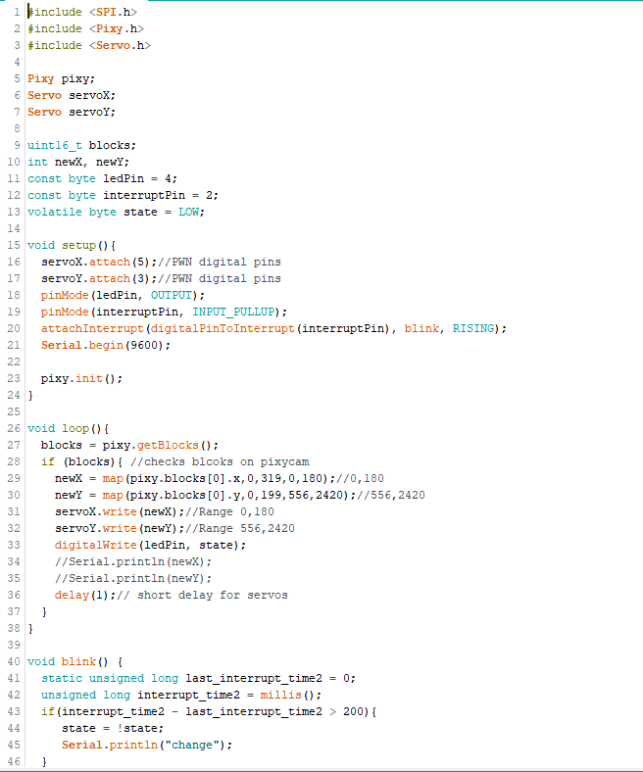
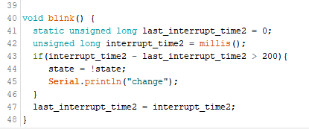
Code

Slide 7
Questions?

